Slide 1
Effectively Deploying Chicago PD by Zip Code
CDT Cooper Klein, USMA ’24
CDT Sydney Watson, USMA ‘24

Slide 2

Background and Problem Statement
Chicago Police Department
Understaffed and cannot maintain presence in every zip code
Understanding spatial and temporal trends will allow for better deployment
Notes:
Other data complexity

Slide 3
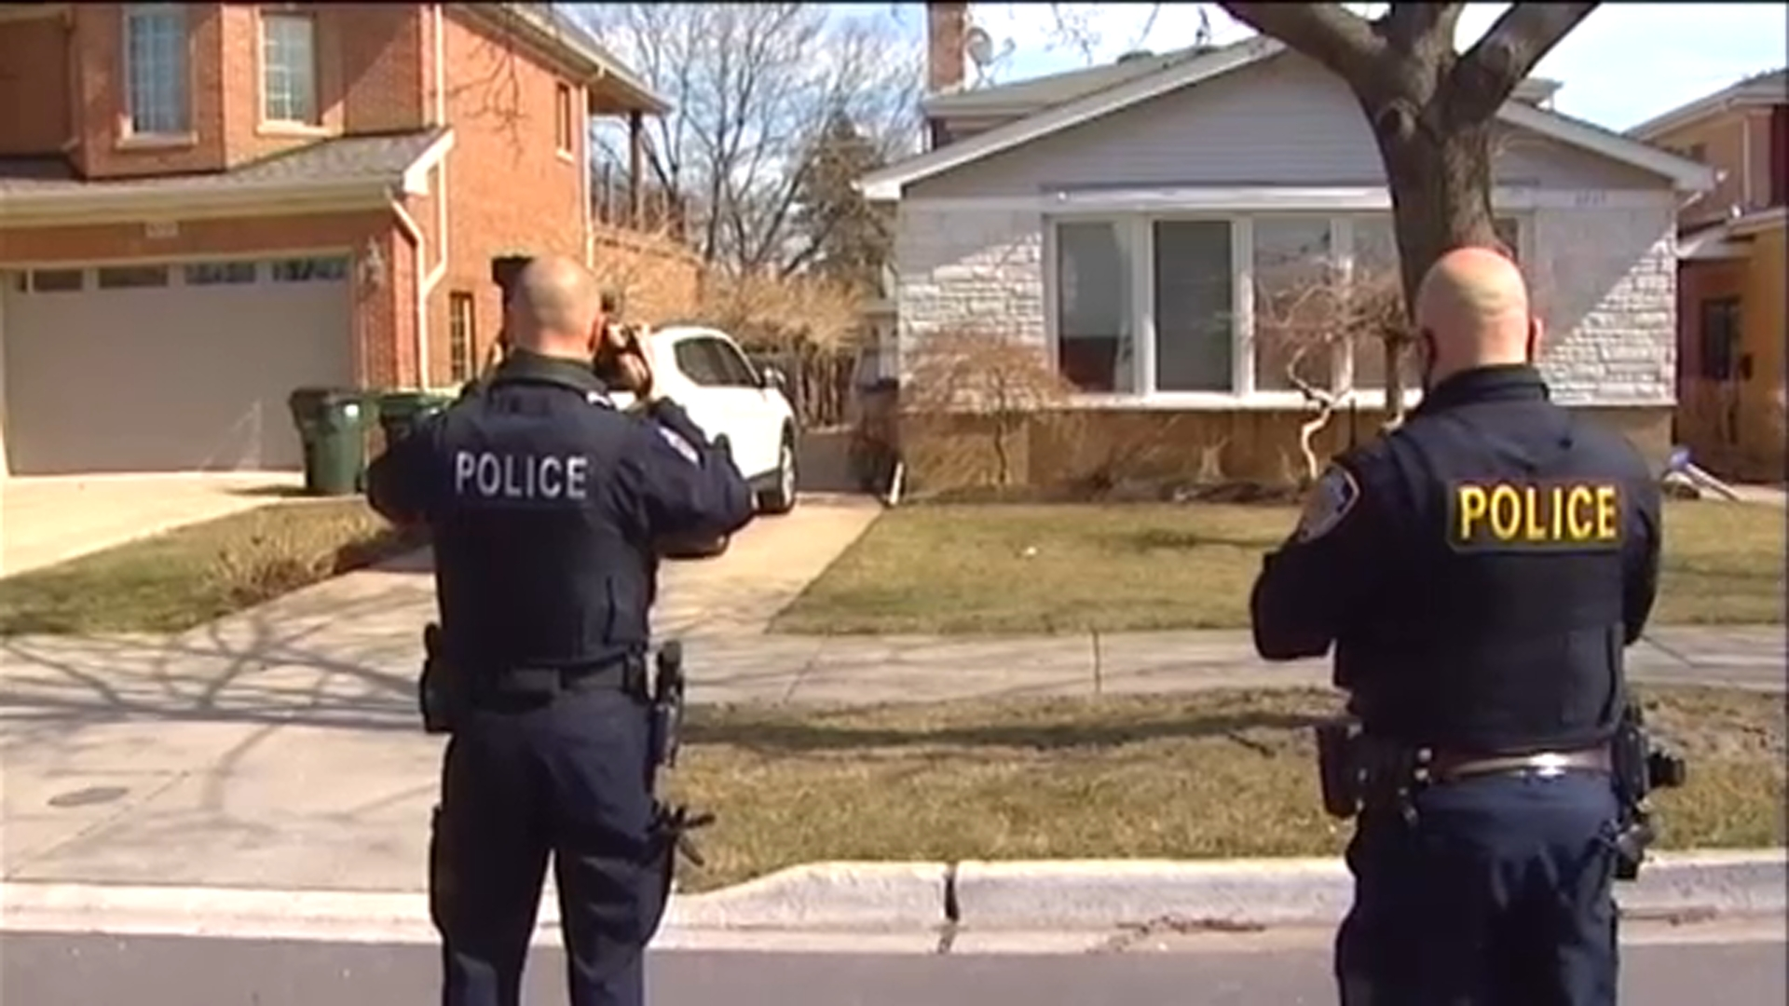
Research Questions
Which socioeconomic factors are associated with the number of burglaries?
Are these socioeconomic factors significant?
Is there an impact of month on burglaries? Should additional officers be hired part time?
Notes:
Other data complexity

Slide 4
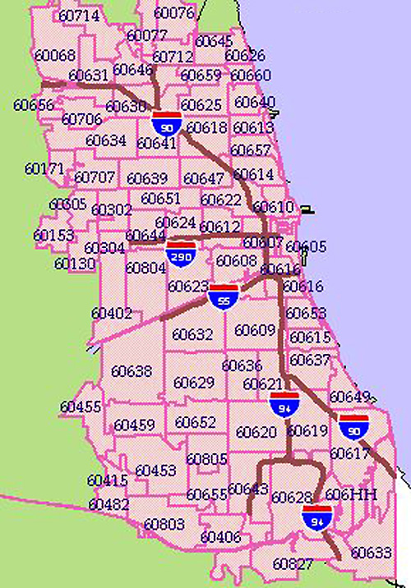
Data Availability
60 Zip Codes
Burglaries JAN2022-DEC2023
Population by age and sex
Median Earnings
Temperature, precipitation by month
Level of Education attained
Poverty in last 12 months
Notes:
Other data complexity

Slide 5
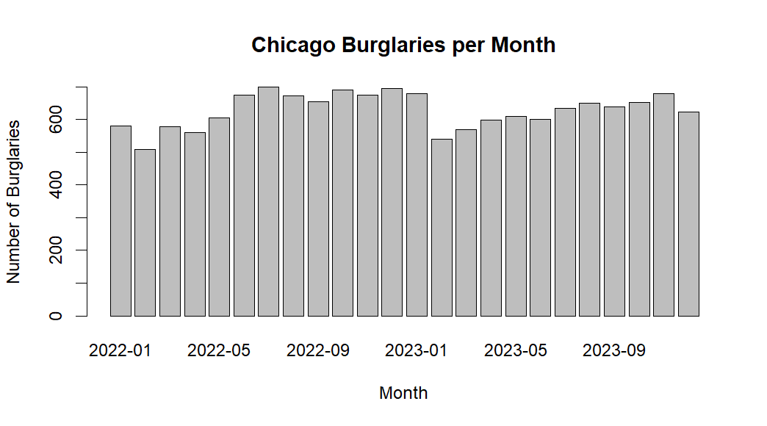
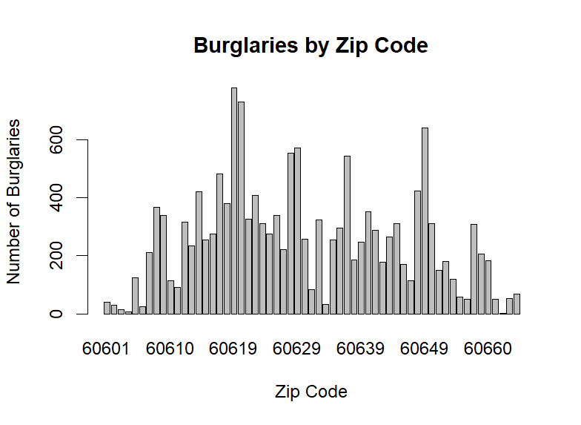
Data Exploration & Proposed Models
Proposed Models
Spatial model with Census covariates
Spatial model accounting for random effect of zip code
Spatial and temporal model with random effects
Notes:
Other data complexity

Slide 6
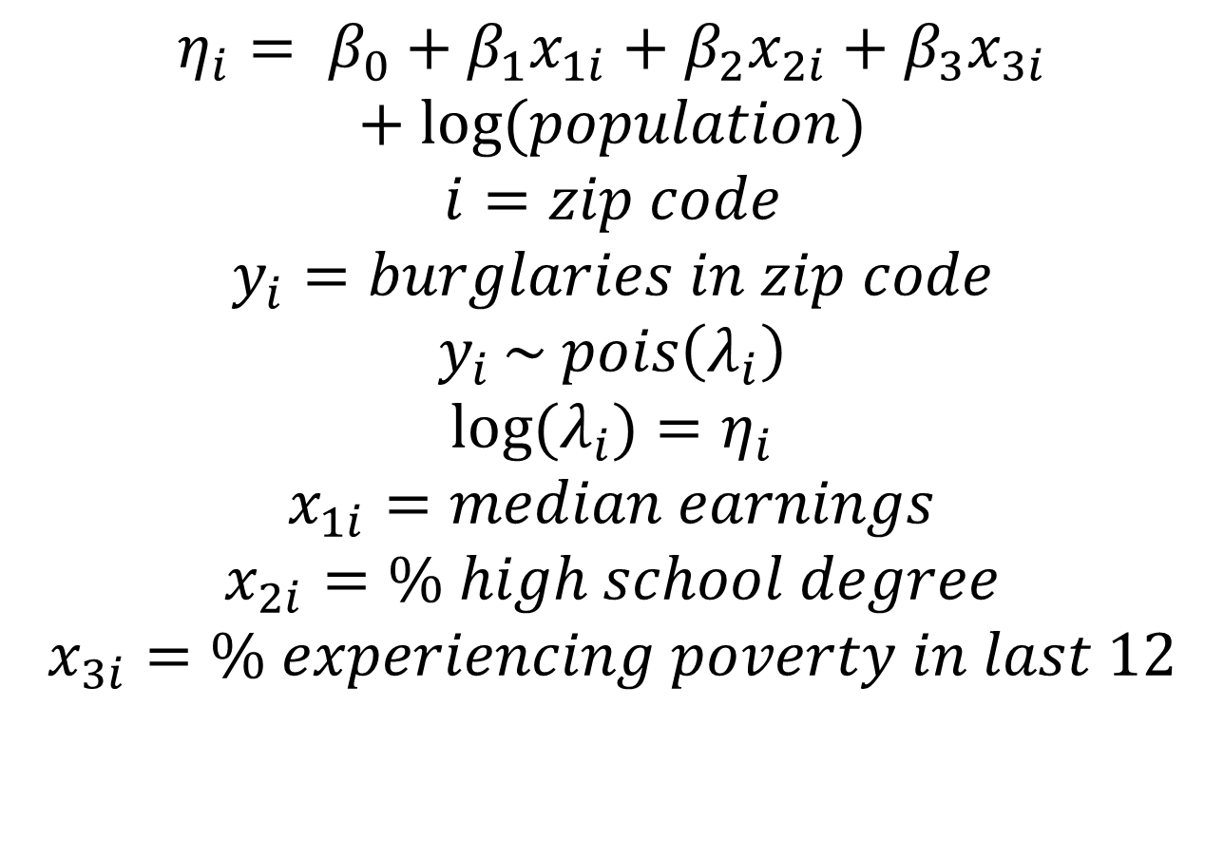
Proposed Models
Which socioeconomic factors are associated with the number of burglaries?
$η_{i}= β_{0}+β_{1}x_{1i}$ $+{ β}_{2}x_{2i}$ $+{ β}_{3}x_{3i}$ $+log⁡(population)$
$$i=zip code$$
$$y_{i}=burglaries in zip code$$
$$y_{i }\sim pois\left(λ_{i}\right)$$
$$log⁡(λ_{i})=η_{i}$$
$$x_{1i}=median earnings$$
$$x_{2i}=\% high school degree$$
$$x_{3i}=\% experiencing poverty in last 12$$
Notes:
Other data complexity

Slide 7
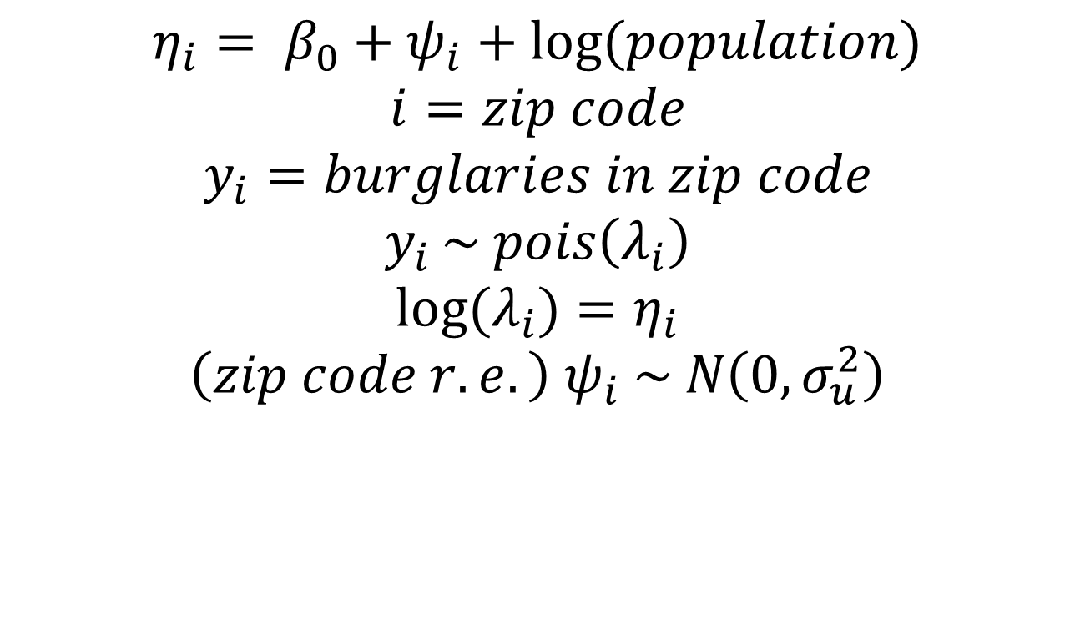
Proposed Models
Are these socioeconomic factors significant?
$$η_{i}= β_{0}+ψ_{i}+log⁡(population)$$
$$i=zip code$$
$$y_{i}=burglaries in zip code$$
$$y_{i }\sim pois\left(λ_{i}\right)$$
$$log⁡(λ_{i})=η_{i}$$
$${\left(zip code r.e.\right) ψ}_{i} \sim N\left(0,σ_{u}^{2}\right)$$
Notes:
Other data complexity

Slide 8
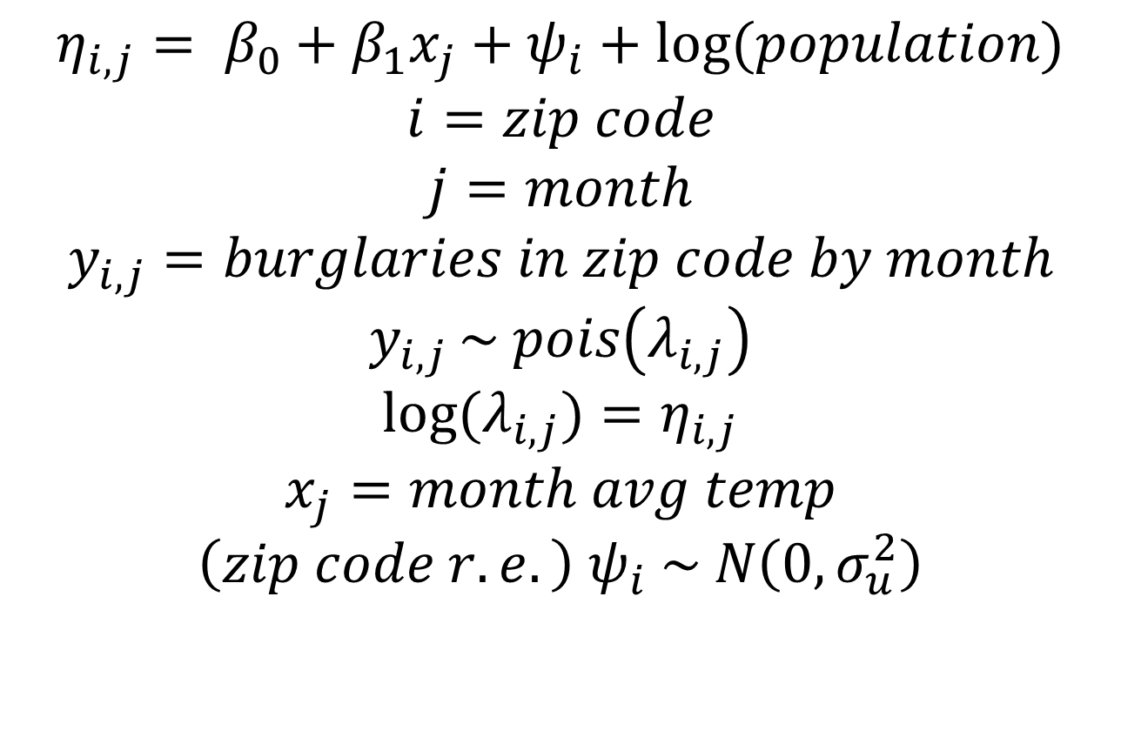
Proposed Models
Is there an impact of month on burglaries? Should additional officers be hired part time?
$$η_{i,j}= β_{0}+β_{1}x_{j}+ψ_{i}+log⁡(population)$$
$$i=zip code$$
$$j=month$$
$$y_{i,j}=burglaries in zip code by month$$
$$y_{i,j }\sim pois\left(λ_{i,j}\right)$$
$$log⁡(λ_{i,j})=η_{i,j}$$
$$x_{j}=month avg temp$$
$${\left(zip code r.e.\right) ψ}_{i} \sim N\left(0,σ_{u}^{2}\right)$$
Notes:
Other data complexity

Slide 9

Questions? Feedback?

